Slide 1

Welcome to Class 10
Mr Corlett & Miss Tattler

Slide 2

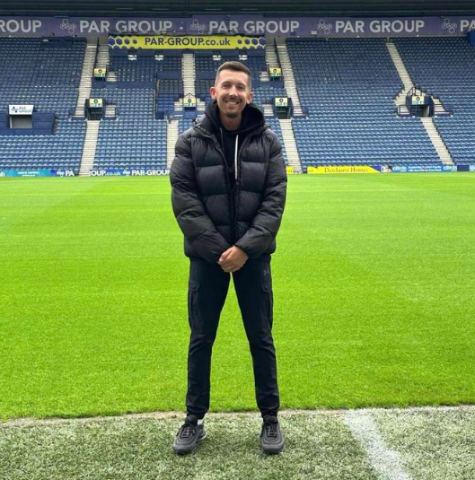
Some Information About Me
Started off as teaching assistant at the age of 19 for 7 years.
Became a qualified teacher and have been working at Fulwood and Cadley for 3+ years.
Proud Gemini, loves Marvel & Harry Potter, favourite drink Vanilla Latte from Costa and loves to sing (but can’t!)
My Ethos
I believe myself to be firm but fair kind of teacher whose main attitude towards teaching is to the get the best out of children.
I treat the class like we are all on the same team and insist that the children work together.
You respect me then I’ll respect you, respect is earned!

Slide 3

Communication is Key
One of the main areas for improvement derived from the parent questionnaire was the need to improve communication and we agree whole heartedly. We are at present trying to find the best app with the capacity to do exactly what we need it to. In the mean time we will continue to use the text and email service for whole school and class info and notices.
The school website (https://www.fulwoodandcadleyprimaryschool.com) has a wealth of up to date information on and is regularly attended to, so please use this as a point of reference. We have set up a parent noticeboard to aid communication and make families aware of whole school messages.
In class 6-11 learning will be shared on Showbie and if you wish to contact class teachers please use their email address, this will be shared on the class newsletters or the website. Teachers may not be able to respond within the school day as they will be teaching, they may have clubs before, after school and at lunchtime, as well as staff meetings. Staff will always strive to respond to you within working hours and in a timely manner. If you wish to have a meeting with your child’s teacher or any other member of staff please contact the office to make an appointment on: 01771 71708

Slide 4
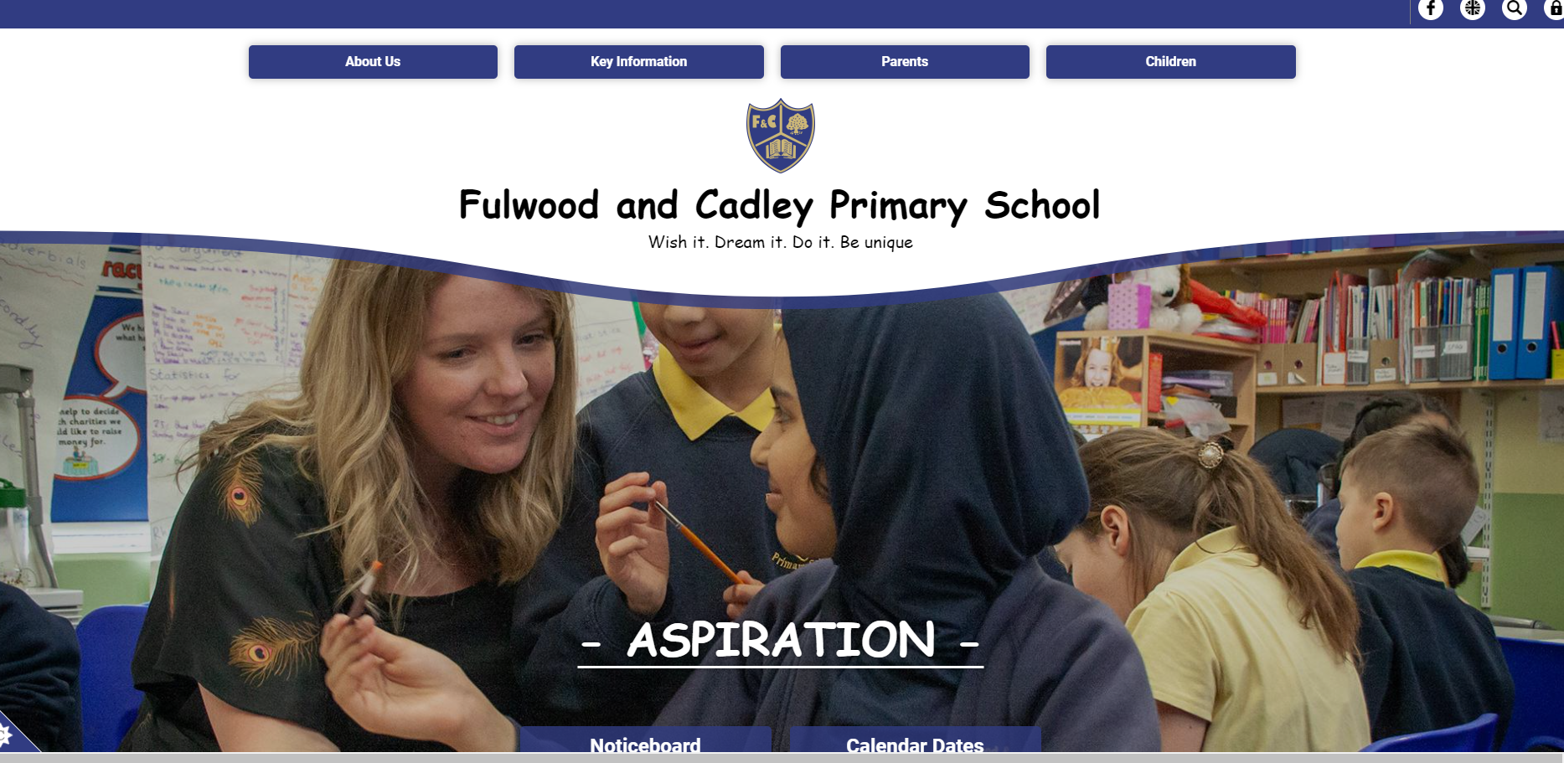
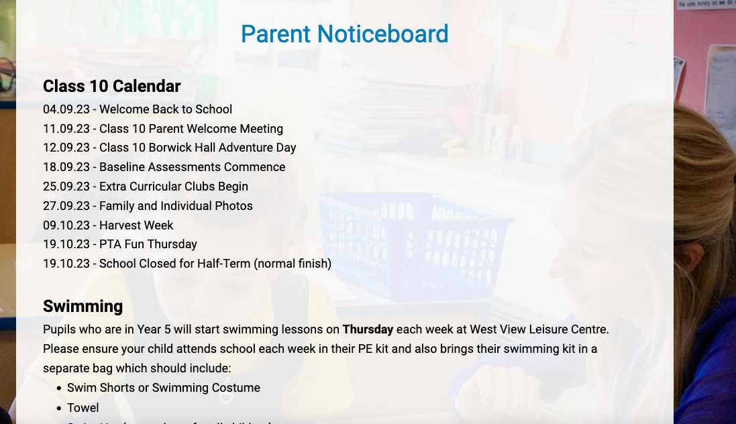
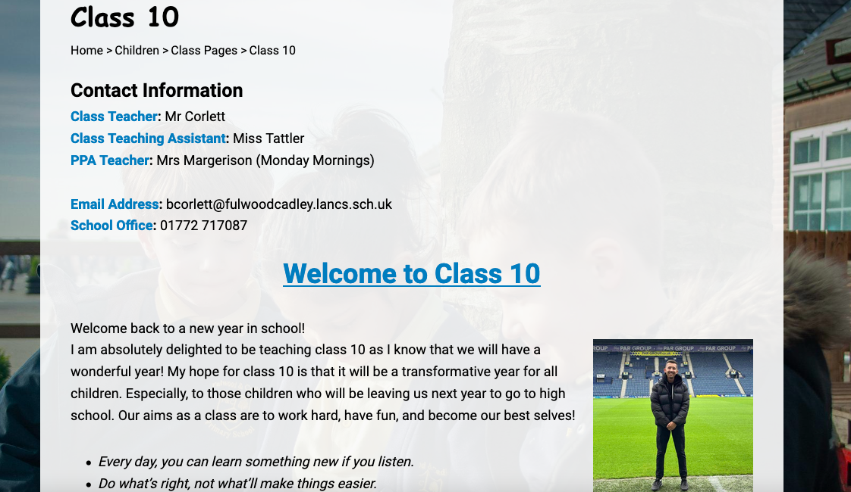
Website/
Class Page
I will continue to use Teachers2Parents for emails and texts if the message is personal or very important.

Slide 5
The school door will open at 8:40am for a staggered entry into school and will close at 8:50am for registration.
Please ensure your child is in school before 8:50am so we can ensure they are settled and ready for the day ahead. This slot allows us to check in with the children, make sure they are ok and ready for the day. If there are any emotions, concerns or problems, we can try to resolve it or if needed, support them throughout the day.
The school day finishes for class 10 at 3:20pm
Morning Matters

Slide 6
Morning break this year will be at the slightly later time of 10:30am so it is really important children have had some breakfast in order for them to get the best out of their learning.
Toast will be available if it has been pre-purchased on parent pay during this time however, if your child hasn’t had breakfast, please ensure you ask them to let us know.
Your child is allowed to bring in a snack at break-time but this must be a healthy option: fruit or cereal bars. Children are not permitted to eat chocolate, crisps etc at break time.
Breakfast

Slide 7
If your child is on a school lunch, each Monday, the teacher will discuss with your child the menu options that are available that week and will ask them to select a choice from the menu for each day that week.
If your child is on a packed lunch, please can your support school by ensuring these are healthy as can be.
Fizzy drinks and chocolate bars are permitted at lunch times.
Lunches

Slide 8
In upper school, it is important we lead by example and set high expectations in relation to behaviour and standards of uniform. Please ensure your child comes to school in the correct school uniform or school PE kit on the correct days. If you are struggling with uniform, please let me know and I will support you in any way I can. If your child does come to school in incorrect footwear e.g. trainers with their school uniform, they will be asked to swap into pumps for the day.
Plea from Mr Corlett – Please name all items of uniform so that if it is lost, it can easily be found and returned back to your child.
Uniform

Slide 9
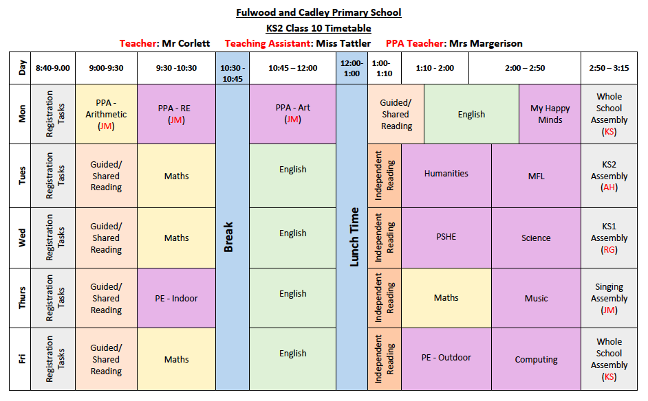
Class Timetable
This is a rough guide to our class timetable.
The mornings will stay the same unless we have another event happening in class or school.
The afternoon lessons are flexible and may change week on week however PE will always remain on a Thursday and a Friday.

Slide 10
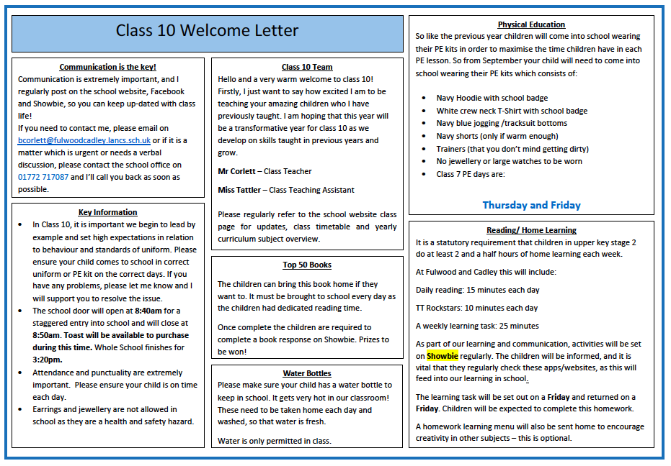
Key
Information

Slide 11
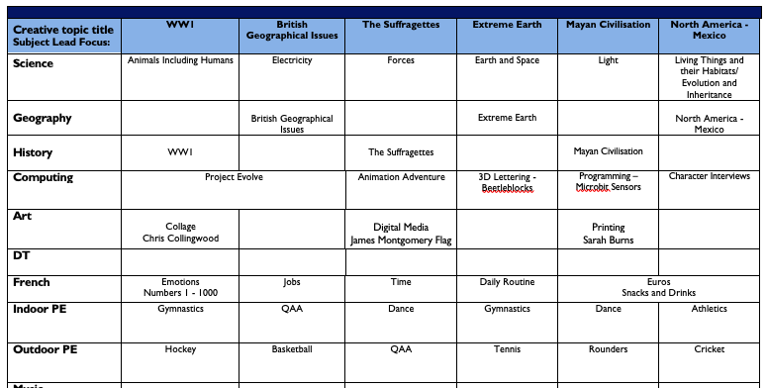
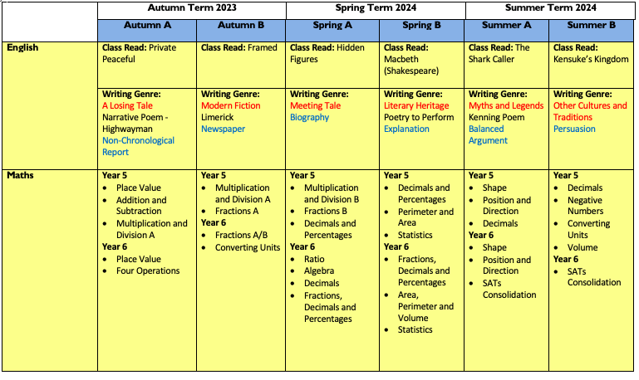
The Year Ahead…

Slide 12

Showbie – How can I find out my child’s progress?
Class Website – new curriculum information each term and a gallery of best bits!
Curriculum updates: Newsletters
Three scheduled parental communication events- one each term either face-to- face or on School Cloud.
SHOWBIE! – Join Showbie as a parent and see what learning your child has been doing in class!
Parental letters with access codes to join.

Slide 13

Homework
In light of some of the feedback from the parental questionnaire, reflection on homework across the school is necessary.
In the coming weeks, the procedures in relation to homework will be reviewed. With the aim of making it more impactful, less time consuming with minimal impact on busy family life and consistent across the school, we will be trialling some new approaches. Senior leaders will be reflecting on research material to establish which are the most effective and impactful. The homework policy will be reviewed and shared with children and families, but in preparation for this we would love to hear from you and the children. A parent questionnaire will be sent out to gather parent views on this. We would appreciate your support greatly with this as it will impact directly on all our children.
Mrs Livesey will be offering children the chance to complete homework on Monday and Wednesday lunchtime if they would like some extra support or struggle to complete fully at home.

Slide 14
Homework Approach to be Trialed
Aim:
Quality not quantity
Secure key knowledge and skills
Weekly Homework:
Daily reading
Spellings
Times Tables
(Y6) SATs Companion
Note from myself:
These are the most important things you can support with as they really are the foundations of learning in all subjects.
Please ensure reading books are brought to and from school every day.

Slide 15
Final Reminder
Our class trip is tomorrow: Tuesday 12th September
9:00 – Leave school for Borwick Hall
10:00-12.00 Outdoor activities
12:00 – 1:00 – Lunch
1:00 – 2.00 – Outdoor activities
2.00 – Leave Borwick Hall to arrive back at School
Please ensure your child has:
A packed lunch on the day. ( If you require school to make a packed lunch for your child please choose via parent pay ham, cheese or tuna.)
Appropriate outdoor clothing that can get wet and muddy and comfy walking shoes.
A small backpack to carry their lunch in
Plenty of water to drink, (no pop)
A spare change of clothes
A carrier bag for wet clothes (in case needed!)

Slide 16
That’s all for now!
Do you have any Questions?

